Slide 1

Effects of Sugar Consumption
CAITLYN Beachey, Amaris assan, Cecilia leung, Hillary mandich, kapil pundhir

Slide 2
PRESENTATION GUIDELINES
Trivial Question
Core Message
Define the Project
Data Exploration
Data Cleanup
Data Analysis
Discussion
Post Mortem
Questions

Slide 3

TRIVIAL QUESTION
Do any of you know what your daily sugar intake should be?

Slide 4

BASED ON THE FACTS…
Men should consume xx amount per day
Women should consume xx amount per day

Slide 5

CORE MESSAGE
“Your Subway sandwich bread is actually a cake!”
~ Article from the Guardian
Upon reading this article, we wondered how high sugar consumption impacts our health.

Slide 6
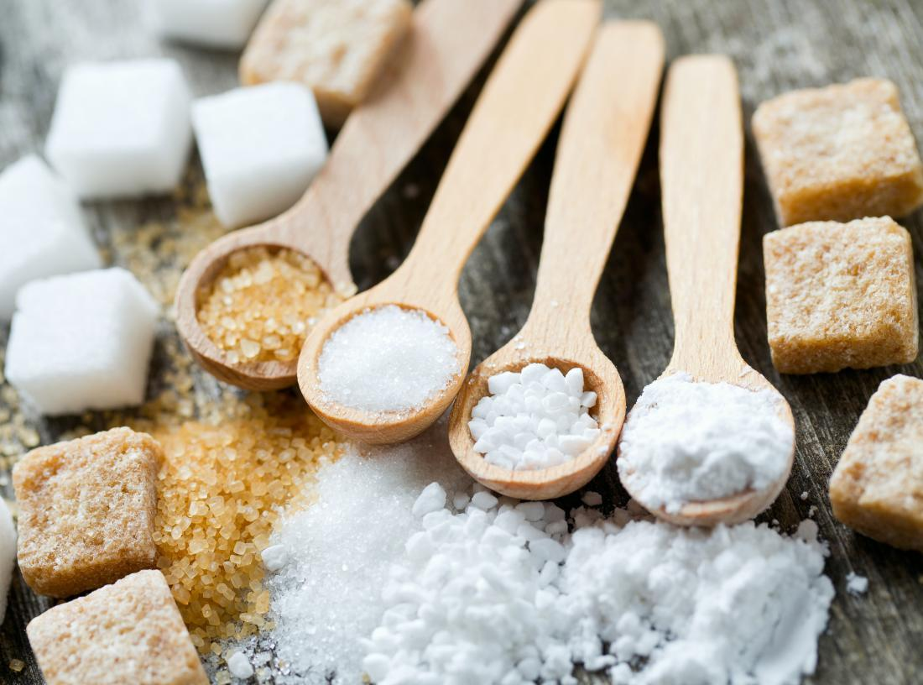
DEFINE THE PROJECT
What is the average daily intake of processed sugar globally? Which countries consume the most on average?
How has the average sugar intake changed over time?
What is the correlation between income and sugar intake?
Is there a correlation between processed sugar and obesity?
Is there a correlation between processed sugar and dental health?
What are the top 5 purchased grocery items in the country with the highest sugar intake? For these 5 top items, what is their sugar content?

Slide 7

DATA CLEANUP – INSIGHTS AND DIFFICULTIES
Requires team effort to brainstorm on where to get the data.
May require paying money to access the optimal data source for analysis.
Time consuming to research the right data for our analysis.
Datasets are not formatted perfectly to answer our questions.
Requires reformatting CSV files in proper rows and columns.
Merging dataframes to determine trends and correlation.
Not all information for a specific country may not be available as some of the countries were not independent until 1990-1993.

Slide 8

DATA EXPLORATION
FAO
Kaggle
Kroger Grocery Data
Fat Secret API
Datasets
WHO
World-bank

Slide 9

INTERESTING DISCOVERY
Upon retrieving the datasets, we were able to find the following trends:
Countries that Consume the most sugars.
Trends of Sugar Consumption over the years.
Correlation of Sugar Consumption between Income, Bad Teeth and Obesity.
Grocery Data of Most Purchased Product.

Slide 10

DATA ANALYSIS

Slide 11
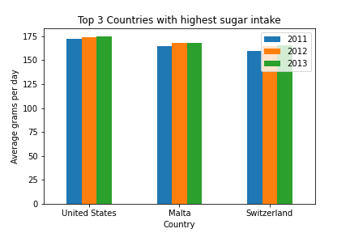
What I the average daily sugar intake and which countries have the highest sugar consumption?
Results:
USA
Malta
Switzerland
Import Average Sugar Intake csv dataset in Jupyter Notebook and create a data frame.
Filter data to 3 years and sort by descending order for average gram to get countries with highest consumption.
Used Matplotlib method to get bar graphs of the countries with the highest consumption.

Slide 12
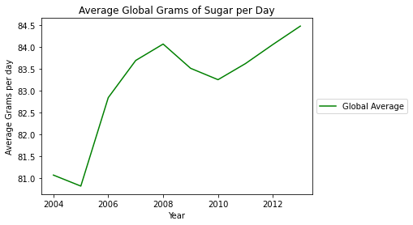
HOW HAS THE AVERAGE SUGAR INTAKE CHANGED OVERTIME?
The trade has shown there has been an increase of sugar intake over the past 10 years.
Import Average Sugar Intake csv dataset in Jupyter Notebook and create a data frame.
Filter data for 10 years and calculate the mean of sugar intake to get the Global Average
Used Matplotlib method to get a line graph to show the trend over the years.

Slide 13
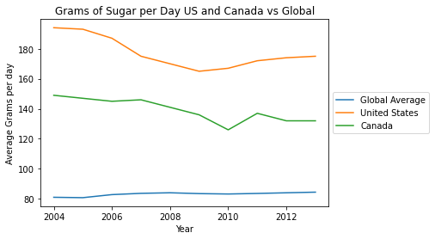
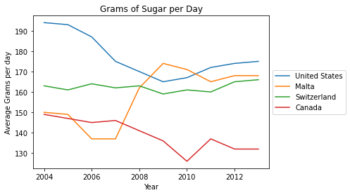
HOW DOES CANADA FARE AGAINST OTHER COUNTRIES?
Canada is still way above the world average.

Slide 14
DATA ANALYSIS - 3
What is the correlation between income and sugar intake?
Comparison of the Income Dataset from Worldbank and Sugar Intake Data from FAO show that countries with lower income has higher sugar intake.
Notes:
AMARIS TO INPUT HER GRAPH → WILL FIX TONIGHT

Slide 15
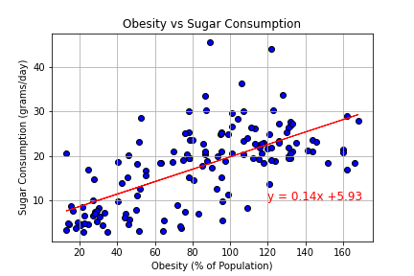
IS THERE A CORRELATION BETWEEN PROCESSED SUGAR AND OBESITY?
Correlation = 0.65
Moderate Correlation
For most cases, obesity rate increases as sugar consumption increases.
Imported the Sugar Intake and Obesity CSV files.
Conducted an inner merge for the two files together to get all the data in 1 Data Frame.
Validated the data and ensure there enough samples to do a Scatterplot.
Used the Matplotlib method to get the scatterplot and linear regression model to determine if the two factors are correlated.

Slide 16
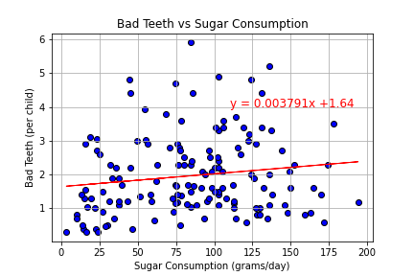
IS THERE A CORRELATION BETWEEN PROCESSED SUGAR AND DENTAL HEALTH?
Correlation = 0.14
Weak Correlation
The 2 variables do not have an effect with one another.
Imported the Sugar Intake and Bad Teeth CSV files.
Conducted an inner merge for the two files together to get all the data in 1 Data Frame.
Validated the data and ensure there enough samples to do a Scatterplot.
Used the Matplotlib method to get the scatterplot and linear regression model to determine if the two factors are correlated.

Slide 17
DATA ANALYSIS - 6
What are the top 5 purchased grocery items in the country with the highest sugar intake? For these 5 top items, what is their sugar content?
The American Kroger grocery store datasets had a list of groceries item purchased by 38,000+ customers. Then we had a nutrition API from Fat Secret to determine the sugar content.
Notes:
Need Kapil and Caitlan to get final graph

Slide 18

DISCUSSIONS AND FINDINGS
Expected Results:
Increase intake in sugar consumption over the last decade.
Lower income households consumes more sugar.
Overall, high sugar consumption can lead to health impacts like obesity.
Unexpected Results:
Bad dental health is not correlated to sugar intake.
Conclusions:
Need to be aware of your sugar intake to maintain a healthy lifestyle.
Unhealthy items are lower priced than healthy/organic products.
Increasing sugar intake will have negative health impacts for the majority.
Increase in Health Care Spending if trend continues.

Slide 19

POST MORTEM
Discuss any difficulties that arose, and how you dealt with them
Discuss any additional questions that came up, but which you didn't have time to answer: What would you research next, if you had two more weeks?
Notes:
Difficulties – API → Kapil to fill in
Questions – How it has impacts on other disease, how it relates to age, does having a healthy lifestyle affect it?

Slide 20


